Slide 1


Introduction
Pravinkumar R .D.

Slide 2
Agenda
Introduction to CSS, SASS, SCSS and LESS
What is SCSS?
Bootstrap and SASS
SASS –
Variables, Nesting, Partials, Modules, Mixins, Extend/Inheritance, Operators, Functions, ‘&’ Operator,
Control Directives - @if, @else, @while, @for
Interpolation and Placeholder
Introduction to Bootstrap

Slide 3
Introduction to CSS
http://www.w3.org/TR/CSS21/
Abstract –
This specification defines Cascading Style Sheets, level 2 revision 1 (CSS 2.1). CSS 2.1 is a style sheet language that allows authors and users to attach style (e.g., fonts and spacing) to structured documents (e.g., HTML documents and XML applications). By separating the presentation style of documents from the content of documents, CSS 2.1 simplifies Web authoring and site maintenance.

Slide 4
Introduction to CSS
http://www.w3.org/TR/CSS/
Abstract –
This section is non-normative. CSS Level 3 builds on CSS Level 2 module by module, using the CSS2.1 specification as its core. Each module adds functionality and/or replaces part of the CSS2.1 specification. The CSS Working Group intends that the new CSS modules will not contradict the CSS2.1 specification: only that they will add functionality and refine definitions. As each module is completed, it will be plugged in to the existing system of CSS2.1 plus previously completed modules

Slide 5
Introduction to SASS
Syntactically Awesome Stylesheet
Stylesheet Language compiled to CSS
An extension to CSS
It is a CSS Preprocessor
Compatible with all the versions of CSS
Reduces repetitions and saves times
Free to use

Slide 6
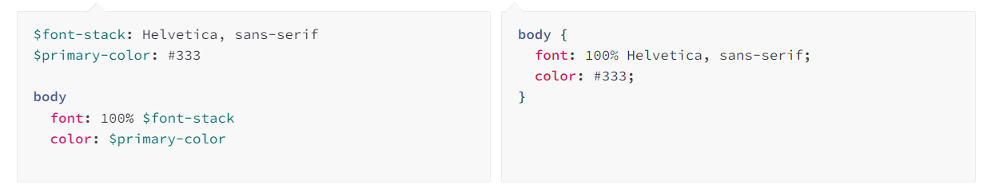
Simple Example of SASS

Slide 7
What is Preprocessing?
CSS does not support features like –
Nesting, Mixins, Inheritance etc.
CSS is getting larger, complex and harder to maintain
This is where SASS comes into the picture –
It takes pre-processed SASS files and saves them as CSS
These saved CSS files then can be deployed/used in our websites

Slide 8
What is SCSS?
Sassy Cascading Stylesheet
Superset of CSS
Syntactically it is very much similar to CSS
Allows the usage of Variables, Nesting, Mixins, Inheritance etc.
Most commonly used syntax of SASS
Number of frameworks and library support the SCSS
Easy to learn and easy to use

Slide 9
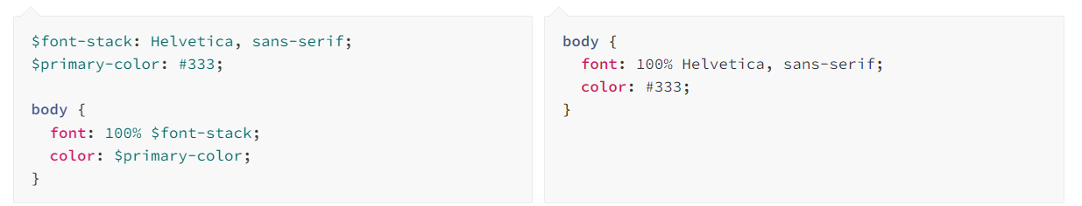
Simple Example of SCSS

Slide 10
What is LESS?
Leaner Style Sheets
Backwards - compatible language extension for CSS
Less.js, the JavaScript tool that converts your Less styles to CSS styles
LESS also supports –
Variables, Nesting, Mixins, Inheritance etc.
Easy to learn and easy to use

Slide 11
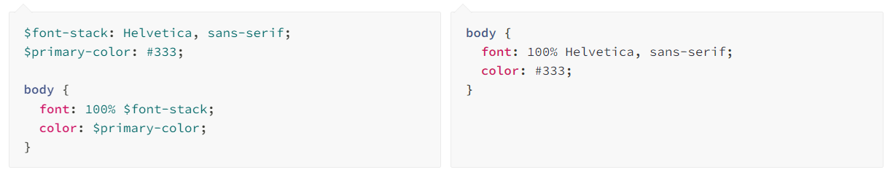
Variables
A way to store information which can be used throughout our stylesheet
Store things like –
Fonts, Colors, Sizes or almost anything
SASS uses $ syntax to declare variables –

Slide 12
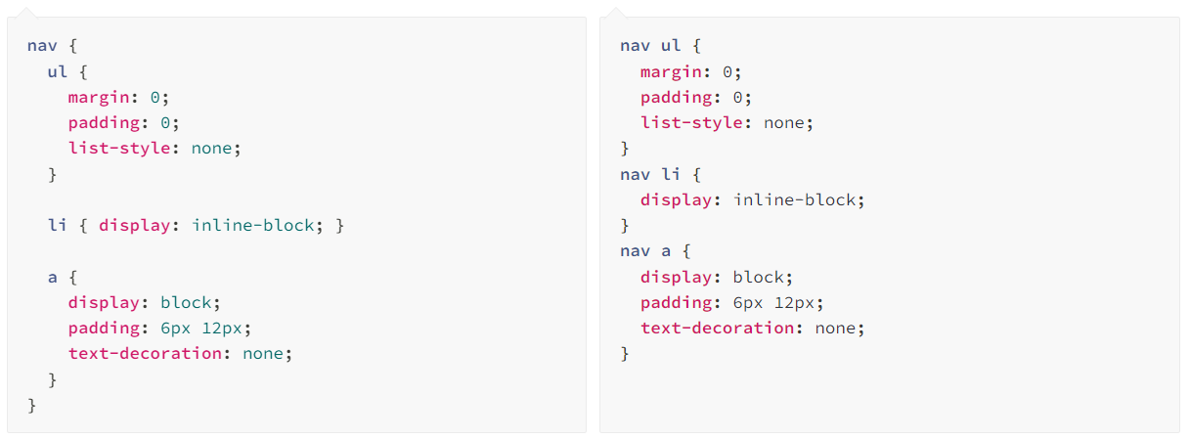
Nesting

Slide 13
Partials
You can create partial SASS file [Promotes to Reusability]
Declare small snippets and use them in other SASS files
Achieve modularity with Partial SASS files
You can declare partial SASS files using underscore notation
For example - _partial.scss
Include them using @use syntax [Simple HTML and CSS]
With Bootstrap, it is - @import

Slide 14
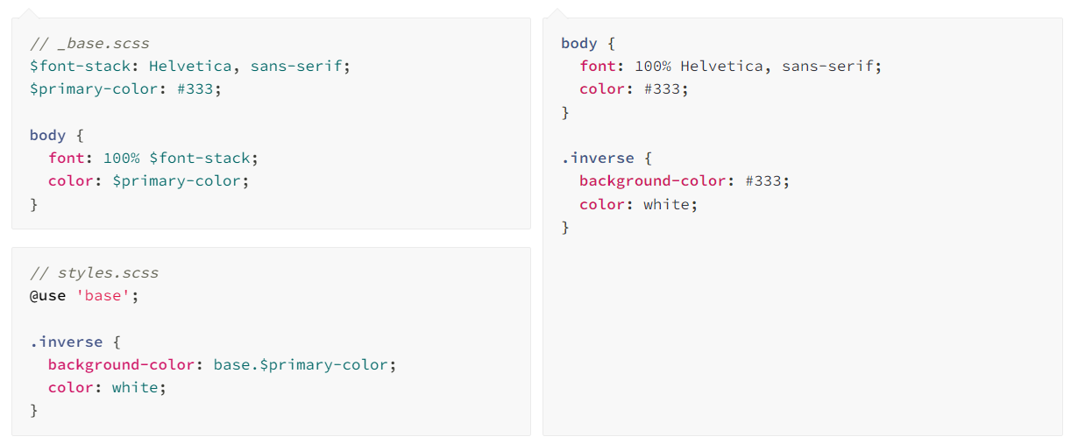
Modules
Dividing SASS into multiple files [Modularity]

Slide 15
Mixins
One of the most powerful feature of SASS
Group multiple CSS together which can be then reused throughout the project
To add Mixin into our code, we use @include() directive
Helps keep our SASS DRY [Don’t Repeat Yourself]
You can also pass values to the Mixin making it more flexible

Slide 16
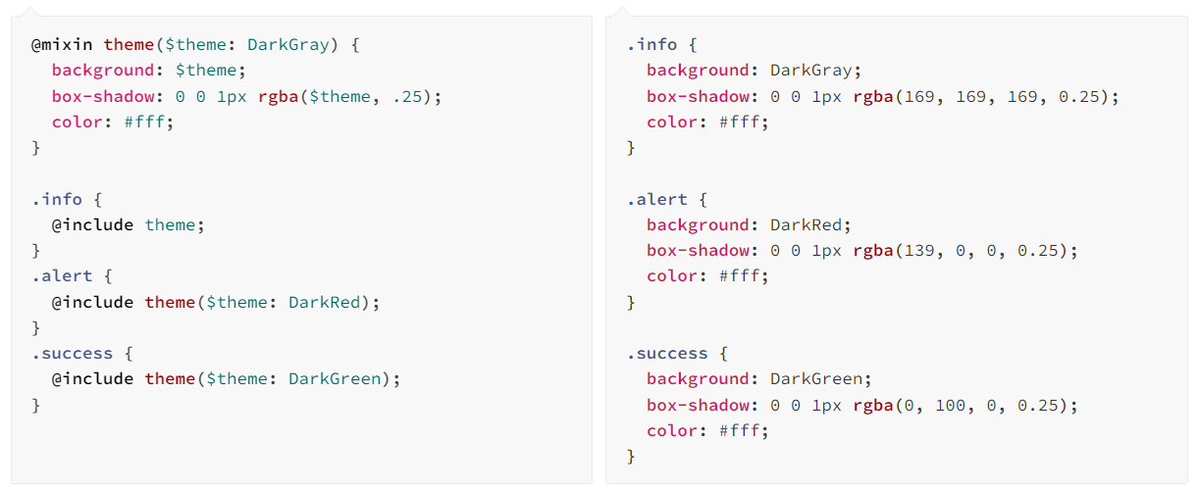
Mixin Example

Slide 17

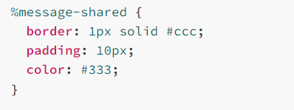
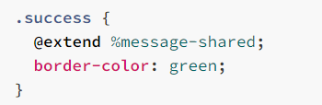
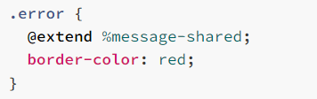
Extend/Inheritance
@extend directive –
Let us use the CSS properties from one selector to another

Slide 18
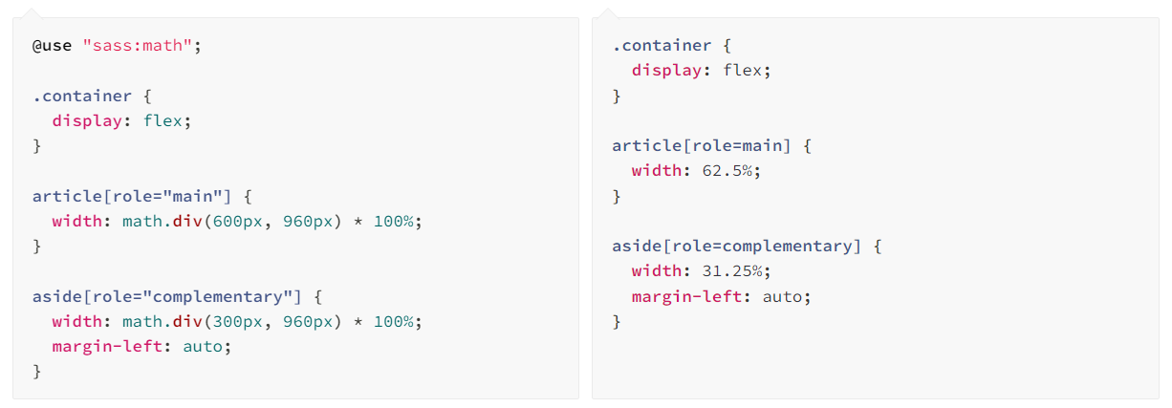
Operators
How to do Math in CSS?
SASS supports handful of standard math operators like –
+, -, *, % etc.

Slide 19
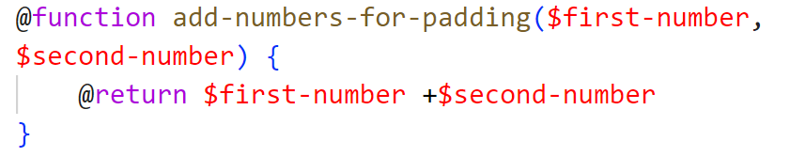
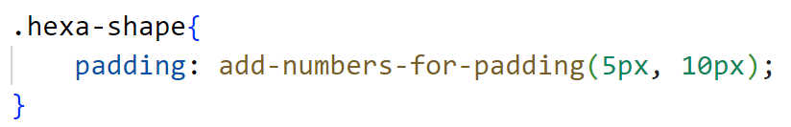
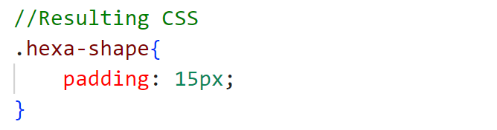
SASS Functions
Functions can receive arguments and return a single value
We will use @function() and @return directives

Slide 20
SASS Maps
Maps in Sass hold pairs of keys and values
You can look up a value by its corresponding key
Different functions –
map-merge
map-remove
Etc.
Maps in SASS are immutable

Slide 21
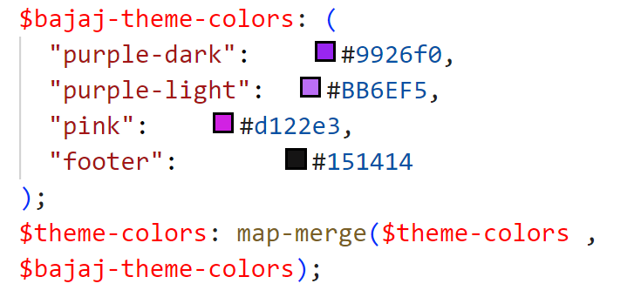
SASS Maps Example

Slide 22
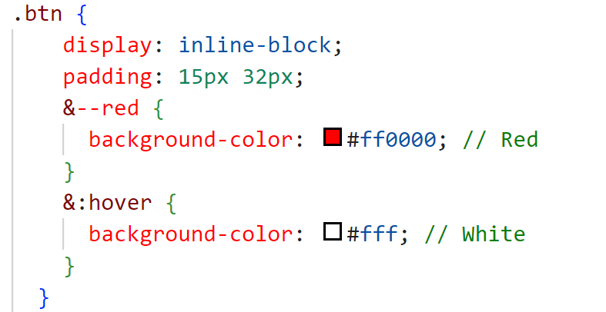

Magic of & Operator
Used when nesting in SASS
Specially used when semantic naming conventions are followed

Slide 23
SASS Control Directives
Include styles only under certain conditions
One of the advance topic mainly used in Mixins
Commonly used directives are –
@if, @else, @for, @while
If/else directives are similar to conditional statements in programming languages [True/False]

Slide 24
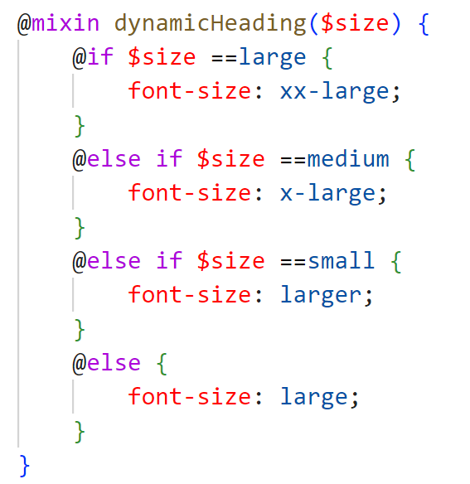
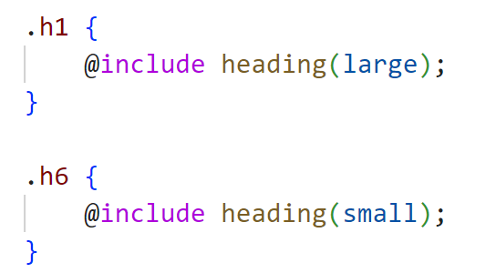
@if and @else – Example

Slide 25
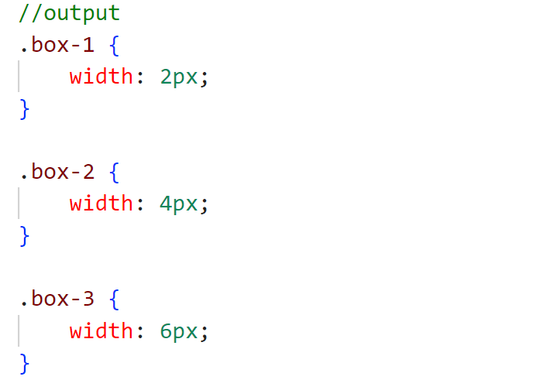
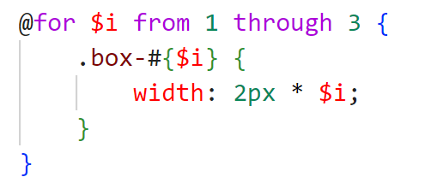
@for – Example

Slide 26
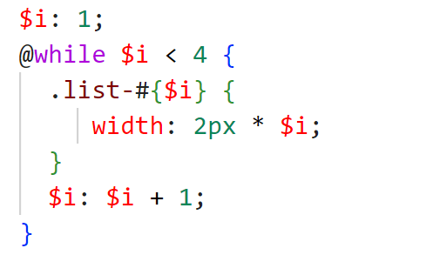
@while – Example

Slide 27
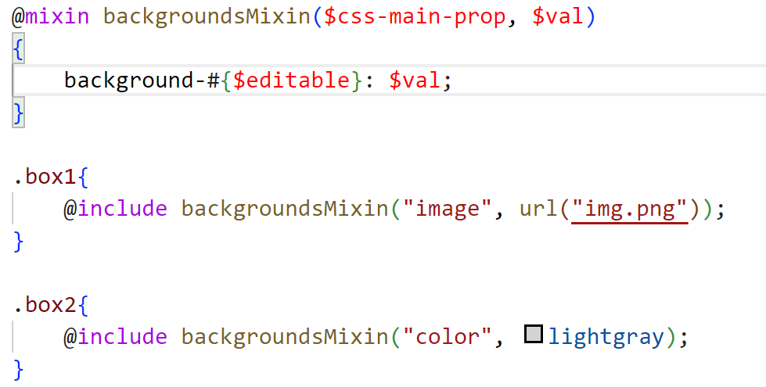
SASS Interpolation
Code insertion in SASS
Interpolate SASS Expressions in our code –
For example – #{expression/variable-name}

Slide 28
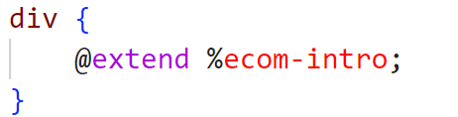
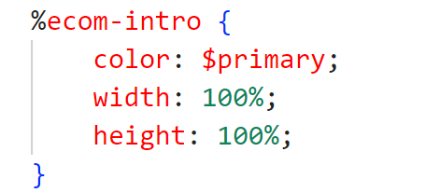
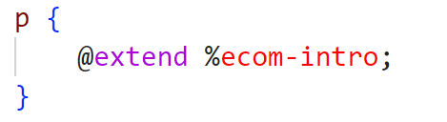
SASS Placeholders
Placeholders look like a class selector
The difference is, it starts with % sign
Placeholders are not included in CSS output

Slide 29
Bootstrap CSS Framework
Bootstrap is free, open source mobile first responsive CSS framework
Contains –
Html, CSS and JavaScript design templates like –
Typography, Forms, Navigation, Layouts, Tables, Images and other interfacing components
Build fast and responsive site with Bootstrap framework
Customization with SASS

Slide 30
Bootstrap and SASS
!default - Declared with SASS Variable –
To allow your users to configure your library’s variables before you use them to generate CSS
To make it possible, SASS provides the !default flag
This assigns a value to a variable only if that variable isn’t defined or its value is null
Otherwise the existing value will be used
Only variables declared at top level of the stylesheet with the !default flag can be configured

Slide 31
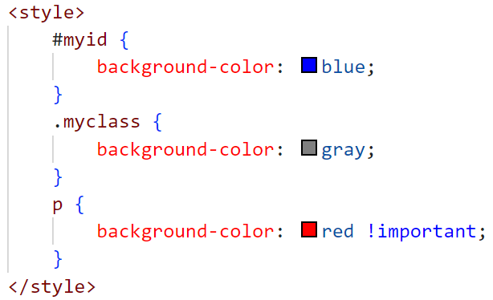
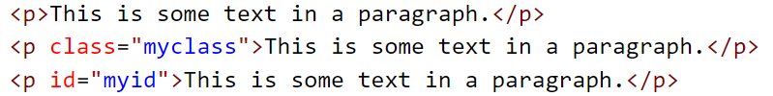

!important
Rule in CSS to add more importance to a property/value than normal

Slide 32
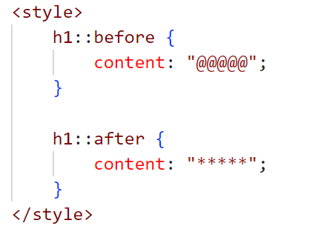
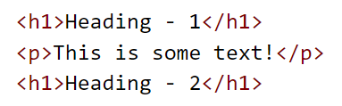
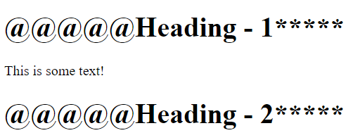
::before and ::after – Pseudo-Elements
::before and ::after –

Slide 33
@using and @forward
@use –
Rule loads mixins, functions, and variables from other SASS stylesheets and combine CSS from multiple stylesheets together
Stylesheet loaded by @use are called as modules
It namespaces your variables
Requiring multiple helper files in each SASS file will be tedious job
Solution is - @forward –
Takes many files and make contents available where the file is required

Slide 34
Let’s get started with Project information!!!

